Slide 1
BITS Pilani presentation
Dr S. S. Chauhan
sansar@wilp.bits-pilani.ac.in

Slide 2
Data Structures and Algorithms Design
Lecture No. 1

Slide 3
Contents
Introduction
Algorithms and it’s Specification,
Random Access Machine Model,
Counting Primitive Operations,
Correctness of Algorithms.
Notion of best case, average case and worst case.

Slide 4
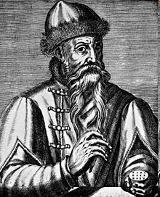
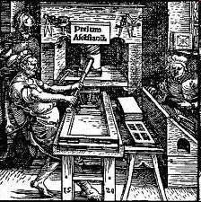
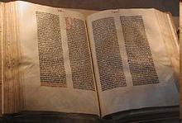
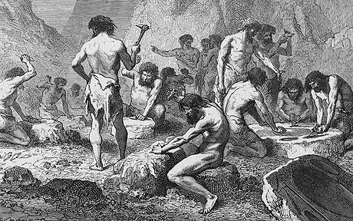
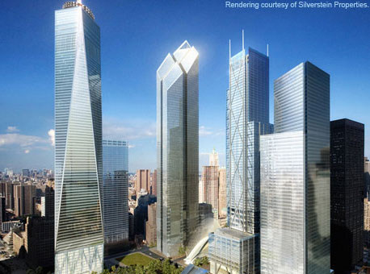
Two discoveries that changed the world !!
Johannes Gutenberg (1398 - February 3, 1468)

Slide 5
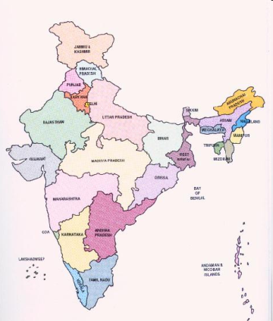
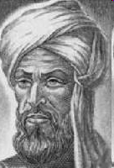
Two discoveries that changed the world !!
Decimal System invented in India around 600AD
Al Khwarizmi (780 AD – 850 AD) from Baghdad laid out basic methods for adding, subtracting, multiplication and dividing numbers
These procedures were precise, unambiguous, mechanical, efficient, correct
In short they were called Algorithms (a term coined to honor Al Khwarizmi - algorithm stem from Algoritmi, the Latin form of his name)

Slide 6
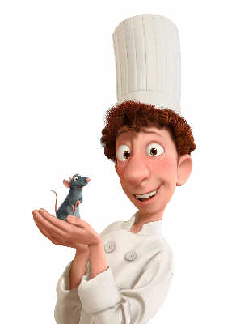

What is an algorithm?
A clearly specified set of simple instructions to be followed to solve a problem
Takes a set of values, as input and
produces a value, or set of values, as output
May be specified
In English or Hindi or Telugu
As a computer program
As a pseudo-code
Input
Algorithm
Output

Slide 7

Some Vocabulary with an example
Problem: Sorting of given keys
Input: A sequence of n keys a1, . . . , an.
Output: The permutation (reordering) of the input sequence such that a1 ≤ a2 ≤ · · · ≤ an−1 ≤ an.
Instance: An instance of sorting might be an array of names, like {Mike, Bob, Sally, Jill ,Jan}, or a list of numbers like {154, 245, 568, 324, 654, 324}
Algorithm: An algorithm is a procedure that takes any of the possible input instances and transforms it to the desired output.

Slide 8


Which algorithm is better?
Who is topper in DSDA?
Algorithm 1:
Sort A into decreasing order
Output A[1].
Algorithm 2:
int i;
int m = A[1];
for (i = 2; i <= n; i ++)
if (A[i] > m)
m = A[i];
return m;
Which is better?

Slide 9



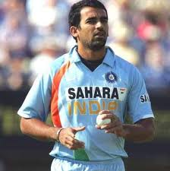
Who’s the champion?

Slide 10
“Better” = more efficient
Time
Space
Measure efficiency (asymptotic notation)
O(n)
o(n)
Ω(n)
Ө(n)

Slide 11
Sorting Algorithms
Comparison Based
Bubble Sort
Quick Sort
Insertion Sort
Merge Sort
Heap Sort
Non-Comp Based
Radix Sort
Bucket Sort
Randomized
Quick Sort
Lower bound on comparison based algorithms

Slide 12
Data Structures
Name of array (Note that all elements of this array have the same name, c)
c[0]
-45
Array
c[1]
6
Linearly Ordered Set
c[2]
0
c[3]
72
c[4]
1543
c[5]
-89
c[6]
0
Head
Linked List
c[7]
62
node
node
c[8]
-3
Data
Next
Data
Next
c[9]
1
c[10]
6453
c[11]
78
object2
object
Position number of the element within array c

Slide 13
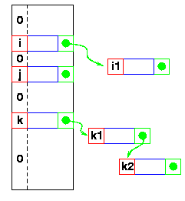
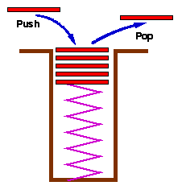
Data Structures
Hash Tables
Stack
Set with delete operation specified (LIFO)
Queue
Remove (Dequeue)
Insert (Enqueue)
front
rear

Slide 14
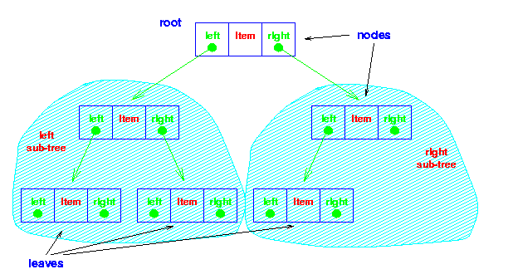
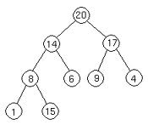

Data Structures
Binary Tree
Heap
26
17
41
Red Black Tree
14
21
30
47
10
16
19
23
28
38
7
12
15
20
35
39
3

Slide 15
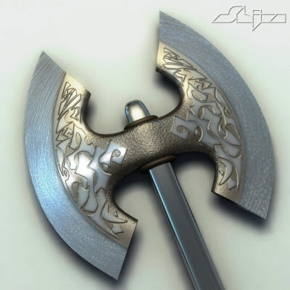
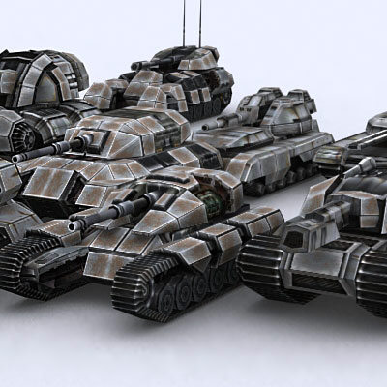
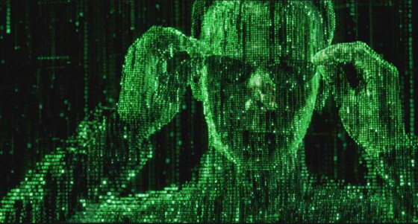

Algorithm Techniques – Divide and Conquer
Matrix Multiplication
Nearest Points

Slide 16
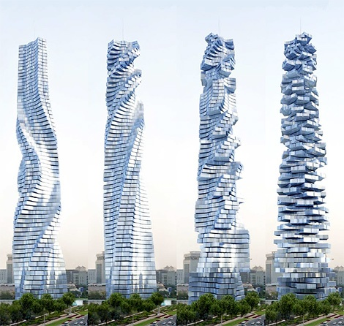
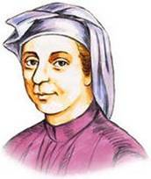
Algorithm Techniques – Dynamic Programming
Efficient algorithm
to compute F(n)
Leonardo Fibonacci
1170-1250

Slide 17
Algorithm Techniques – Dynamic Programming
Matrix Chain Product

Slide 18

Algorithm Techniques – Greedy Approach
Krusal’s Minimum Spanning Tree Algorithms
8
10
14
10
14
1
3
5
7
1
3
5
7
7
3
7
4
6
3
2
4
12
6
2
2
4
6
8
2
4
6
8
9
Prim’s Minimum Spanning Tree Algorithms
8
10
14
10
14
1
3
5
7
1
3
5
7
7
3
7
4
6
3
2
4
12
6
2
2
4
6
8
2
4
6
8
9

Slide 19
Algorithm Techniques – Greedy Approach
Task Selection Problem: Selecting as many disjoint tasks as possible.

Slide 20
Graph Algorithms
u
3
2
2
Shortest Path Algorithms:
Dijkstra’s,
Floyd-Warshall’s
All Pairs Shortest Path Algoirthm
1
1
3
-3
1
v
2
MST Algorithms:
Kruskal & Prim (emphasis on Greedy approach )
Graph Search Methods:
BFS
DFS

Slide 21
P, NP, NP-Complete, NP Hard
Complexity Class P
Set of all decision problems (or languages) that can be solved in polynomial time
Complexity Class NP
Set of all decision problems (or languages) that can be verified by a polynomial-time algorithm
NP-completeness
A language L is NP-complete if
L is in NP and
All other languages in NP are polynomially reducible to L
NP-hard
A language L is NP-hard if
All other languages in NP are polynomially reducible to L
NPC
NP
P

Slide 22
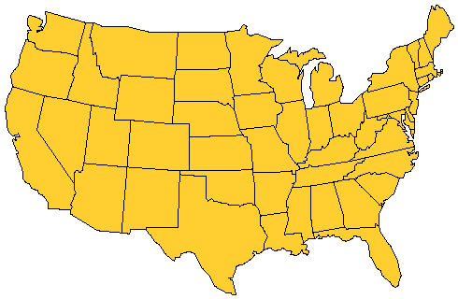
P, NP, NP-Complete, NP Hard
Home city
Visit city
Notes:
Once a month the salesperson starts from home and visits each city in his/her territory once. When done, the salesperson returns home. The salesperson wishes to minimize time spent in this activity. Assuming that the time spent at each city is fixed, total time is minimized by minimizing travel time. So, a tour of minimum length is desired.

Slide 23
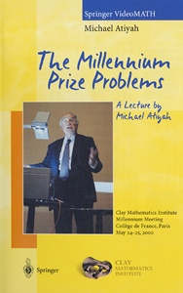
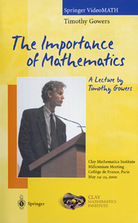
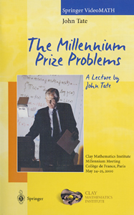

Millennium problems (US $1,000,000 per problem)
Birch and Swinnerton-Dyer Conjecture
Hodge Conjecture
Navier-Stokes Equations
Is P = NP?
Poincaré Conjecture
Riemann Hypothesis
Yang-Mills Theory

Slide 24
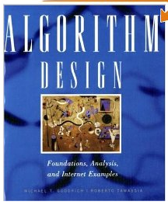
Text Book
Micheal T. Goodrich and Roberto Tamassia: Algorithm Design: Foundations, Analysis and Internet examples (John Wiley &Sons, Inc., 2002)

Slide 25
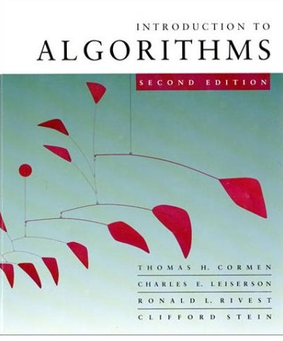



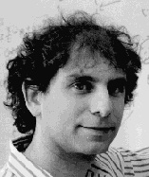
Reference Books
Also known as CLRS book

Slide 26
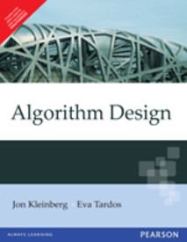
Reference Books
Jon Kleinberg and Eva Tardos. Algorithm Design. Pearson Education. (2007)

Slide 27
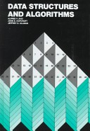
Reference Books
Data Structures and Algorithms - Alfred V. Aho, John E. Hopcroft, Jeffery D.Ulman

Slide 28
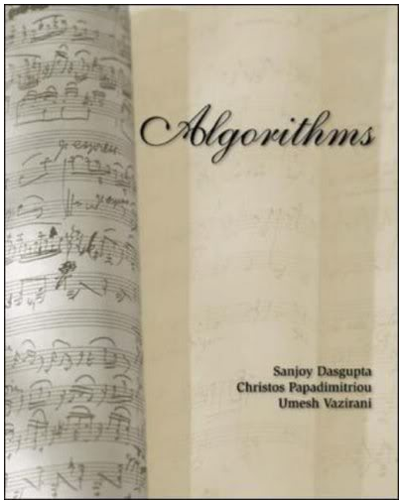

Reference Books
Sanjoy Das Gupta, Christos Papadimitriou, Umesh Vazirani: Algorithms
(Tata McGraw-Hill Publishers)

Slide 29
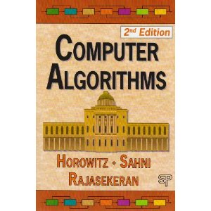
Reference Books
Ellis Horowitz, Sartaj Sahni, Sanguthevar Rajasekaran. Computer Algorithms

Slide 30
Semester Calendar for DSE 2019 (1) and DSE 2019 (2)
..\..\Detailed Cal (1).pdf

Slide 31
Introduction
Algorithms and it’s Specification,
Random Access Machine Model,
Counting Primitive Operations,
Notion of best case, average case and worst case.

Slide 32
Definition: Data Structure
Organization of large amount of data such that, the operations we perform on data are efficient.
Criteria of judging an operation(algorithm)
CPU
MEMORY
DISK(I/O)
No of message exchanges to perform a task(N/W).

Slide 33
Pseudo Code
A mixture of natural language and high level programming concepts used to represent an algorithm.

Slide 34
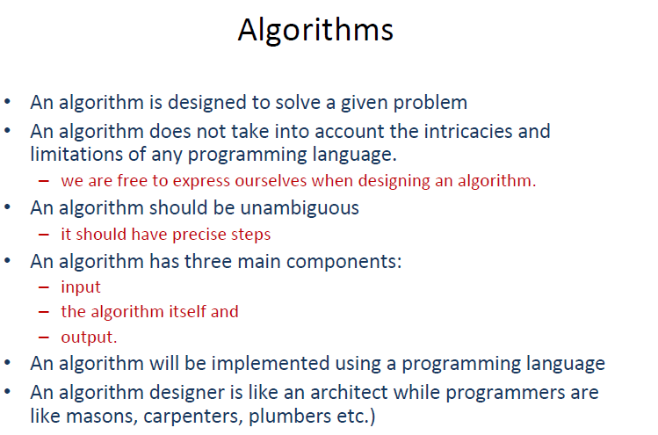

Slide 35
Characteristics of an algorithm:-
· Must take an input.
· Must give some output(yes/no,valueetc.)
· Definiteness –each instruction is clear and unambiguous.
· Finiteness –algorithm terminates after a finite number of steps.
· Effectiveness –every instruction must be basic i.e. simple instruction.

Slide 36
Expectation from an algorithm
Correctness:-
Correct: Algorithms must produce correct result. Approximation algorithm: Exact solution is not found, but near optimal solution can be found out. (Applied to optimization problem.)
Less resource usage:
Algorithms should use less resources (time and space).

Slide 37
Why Algorithm
CG needs primitives by geometric algo.
Routing uses shortest path algo
Cryptography Number theory
Computation biology uses dynamic programming.
Database needs balanced tree data structure and algorithm.
Sort a bunch of numbers
Shortest path
Route Optimization
Searching
Indexing
Any or every computation in efficient way.

Slide 38
To analyse an algorithm
Code and execute, find actual time.
What does the total time depend upon
Algorithm
Number of inputs
Count the number of primitive operations like assignment, function call, control transfer, arithmetic etc.
Solution to all issues is : Asymptotic analysis of algorithms.

Slide 39
A survey suggest that we have gained more efficiency than as compared to hardware or processor speed development through algorithms instead.

Slide 40
Random Access Machine Model
Random Access Machine : Processor + memory
All type of instruction take single step for execution.

Slide 41
The Random Access Machine (RAM) Model
A CPU
Potentially unbounded bank of memory cells, each of which can hold an arbitrary number or character
2
1
0
Memory cells are numbered and accessing any cell in memory takes unit time.

Slide 42
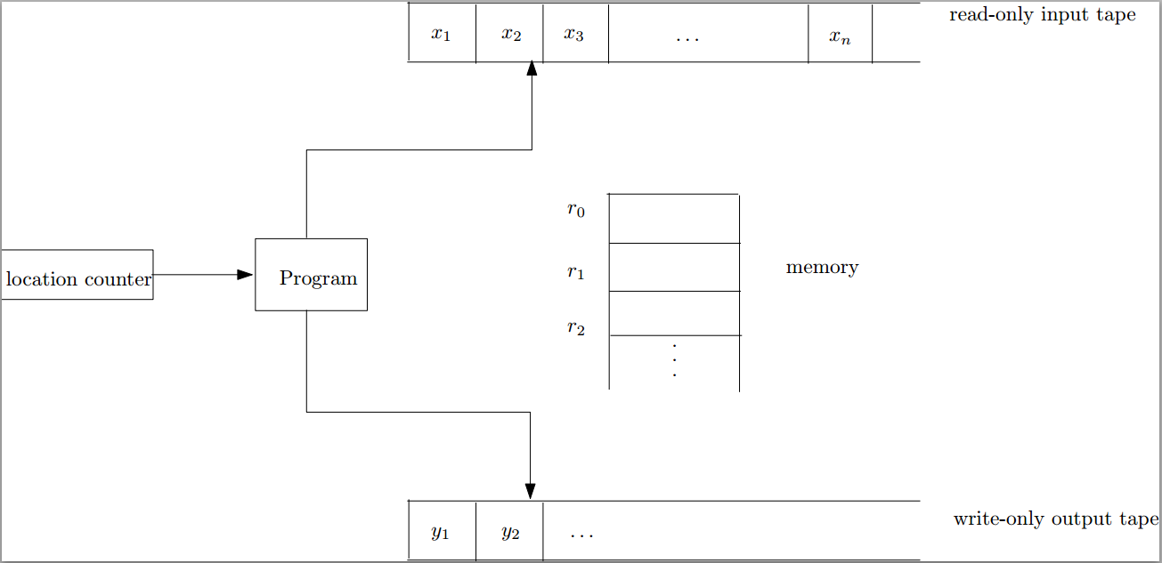
Random Access Model (RAM)
Time complexity (running time) = number of instructions executed
Space complexity = the number of memory cells accessed

Slide 43
Our Machine Model
Generic Random Access Machine (RAM)
Executes operations sequentially
Set of primitive operations:
Arithmetic. Logical, Comparisons, Function calls
Simplifying assumption: all ops cost 1 unit
Eliminates dependence on the speed of our computer, otherwise impossible to verify and to compare

Slide 44
Primitive Operations
Basic computations performed by an algorithm
Identifiable in pseudocode
Largely independent from the programming language
Exact definition not important (we will see why later)
Examples:
Evaluating an expression
Assigning a value to a variable
Indexing into an array
Calling a method
Returning from a method

Slide 45
Analyzing pseudocode (by counting)
For each line of pseudocode, count the number of primitive operations in it. Pay attention to the word "primitive" here; sorting an array is not a primitive operation.
Multiply this count with the number of times this line is executed.
Sum up over all lines.

Slide 46
Counting Primitive Operations
By inspecting the pseudocode, we can determine the maximum number of primitive operations executed by an algorithm, as a function of the input size
Algorithm arrayMax(A, n
Cost Times
currentMax ← A[0] 2 1
for i ← 1 to n − 1 do 2 n
if A[i] > currentMax then 2 (n − 1)
currentMax ← A[i] 2 (n − 1)
{ increment counter i } 2 (n − 1)
return currentMax 1 1
Total 8n − 3

Slide 47
Insertion Sort
6
10
24
36
12

Slide 48
Insertion Sort
input array
5 2 4 6 1 3
at each iteration, the array is divided in two sub-arrays:
left sub-array
right sub-array
sorted
unsorted

Slide 49
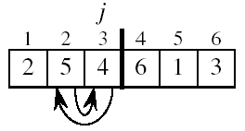
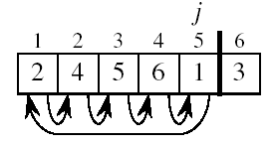
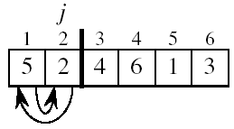
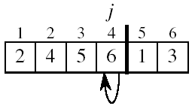
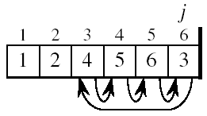
Insertion Sort

Slide 50
INSERTION-SORT
Alg.: INSERTION-SORT(A)
for j ← 2 to n
do key ← A[ j ]
Insert A[ j ] into the sorted sequence A[1 . . j -1]
i ← j - 1
while i > 0 and A[i] > key
do A[i + 1] ← A[i]
i ← i – 1
A[i + 1] ← key
Insertion sort – sorts the elements in place
1
2
3
4
5
6
7
8
a₁
a₂
a₃
a₄
a₅
a₆
a₇
a₈
key

Slide 51
Correctness of algorithms by loop Invariant

Slide 52
Loop Invariant for Insertion Sort
Alg.: INSERTION-SORT(A)
for j ← 2 to n
do key ← A[ j ]
Insert A[ j ] into the sorted sequence A[1 . . j -1]
i ← j - 1
while i > 0 and A[i] > key
do A[i + 1] ← A[i]
i ← i – 1
A[i + 1] ← key
Invariant: at the start of the for loop the elements in A[1 . . j-1] are in sorted order

Slide 53
Proving Loop Invariants
Proving loop invariants works like induction
Initialization (base case):
It is true prior to the first iteration of the loop
Maintenance (inductive step):
If it is true before an iteration of the loop, it remains true before the next iteration
Termination:
When the loop terminates, the invariant gives us a useful property that helps show that the algorithm is correct
Stop the induction when the loop terminates

Slide 54
Loop Invariant for Insertion Sort
Initialization:
Just before the first iteration, j = 2:
the subarray A[1 . . j-1] = A[1], (the element originally in A[1]) – is sorted

Slide 55
Loop Invariant for Insertion Sort
Maintenance:
the while inner loop moves A[j -1], A[j -2], A[j -3], and so on, by one position to the right until the proper position for key (which has the value that started out in A[j]) is found
At that point, the value of key is placed into this position.

Slide 56

Loop Invariant for Insertion Sort
Termination:
The outer for loop ends when j = n + 1 ⇒ j-1 = n
Replace n with j-1 in the loop invariant:
the subarray A[1 . . n] consists of the elements originally in A[1 . . n], but in sorted order
The entire array is sorted!
j - 1
j
Invariant: at the start of the for loop the elements in A[1 . . j-1] are in sorted order

Slide 57
Analysis of Insertion Sort
INSERTION-SORT(A)
for j ← 2 to n
do key ← A[ j ]
Insert A[ j ] into the sorted sequence A[1 . . j -1]
i ← j - 1
while i > 0 and A[i] > key
do A[i + 1] ← A[i]
i ← i – 1
A[i + 1] ← key
cost times
c₁ n
c₂ n-1
0 n-1
c₄ n-1
c₅
c₆
c₇
c₈ n-1
t_{j}: # of times the while statement is executed at iteration j
Notes:
₇

Slide 58
Best Case Analysis
The array is already sorted
A[i] ≤ key upon the first time the while loop test is run (when i = j -1)
t_{j} = 1
T(n) = c₁n + c₂(n -1) + c₄(n -1) + c₅(n -1) + c₈(n-1) = (c₁ + c₂ + c₄ + c₅ + c₈)n + (c₂ + c₄ + c₅ + c₈)
= an + b = Θ(n)
“while i > 0 and A[i] > key”

Slide 59
Worst Case Analysis
The array is in reverse sorted order
Always A[i] > key in while loop test
Have to compare key with all elements to the left of the j-th position ⇒ compare with j-1 elements ⇒ t_{j} = j
a quadratic function of n
T(n) = Θ(n²) order of growth in n²
“while i > 0 and A[i] > key”
using
we have:

Slide 60
Comparisons and Exchanges in Insertion Sort
cost times
c₁ n
c₂ n-1
0 n-1
c₄ n-1
c₅
c₆
c₇
c₈ n-1
INSERTION-SORT(A)
for j ← 2 to n
do key ← A[ j ]
Insert A[ j ] into the sorted sequence A[1 . . j -1]
i ← j - 1
while i > 0 and A[i] > key
do A[i + 1] ← A[i]
i ← i – 1
A[i + 1] ← key
≈ n²/2 comparisons
≈ n²/2 exchanges

Slide 61
Insertion Sort - Summary
Advantages
Good running time for “almost sorted” arrays Θ(n)
Disadvantages
Θ(n²) running time in worst and average case
≈ n²/2 comparisons and exchanges

Slide 62
Thank You!!

